Slide 1
Delivery Platform Evaluation and Restaurants Analysis with visualization on tableau
BY
ADEBAYO ABDULMALIK

Slide 2
INTRODUCTION
The food delivery and catering industry operates in a fast-paced, customer-centric environment. However, challenges such as delivery delays, inconsistent revenue streams, inefficient discount strategies, and limited customer insight can impact overall profitability.
Goal:
To Evaluate Performances, Identify lapses, recommend solution and uncover actionable insights that can improve operational efficiency, satisfaction, and profitability for the platform.

Slide 3
OBJECTIVES
Customer Behavior Analysis
Distribution of Orders by Payment Method
Top Customers by Total Spend & Order Frequency
Restaurants Performance Evaluation
Revenue and Cost Analysis
Breakdown of Platform Earnings and losses
EFFECT OF Each PROMO on sales
Correlation btw Orders and Commission fee
Promotions & Discounts Impact
Evaluate Impact on order
Evaluate Impact volume and revenue
Payment Method Analysis

Slide 4
DATA ANALYSIS
Found most common payment method: Cash on Delivery
Identified most used Discount and offers
Evaluated top best customers and restaurants by revenue and order quantity
Estimated revenue made by each restaurants and the total
Estimated the total revenue made by the platform and the breakdown
Assessed delivery duration
Quantified how discounts affect order values and frequency
Assessed how the commission and payment processing fee is being charged
Analyzed the earnings on the platform over time for the first quarter

Slide 5
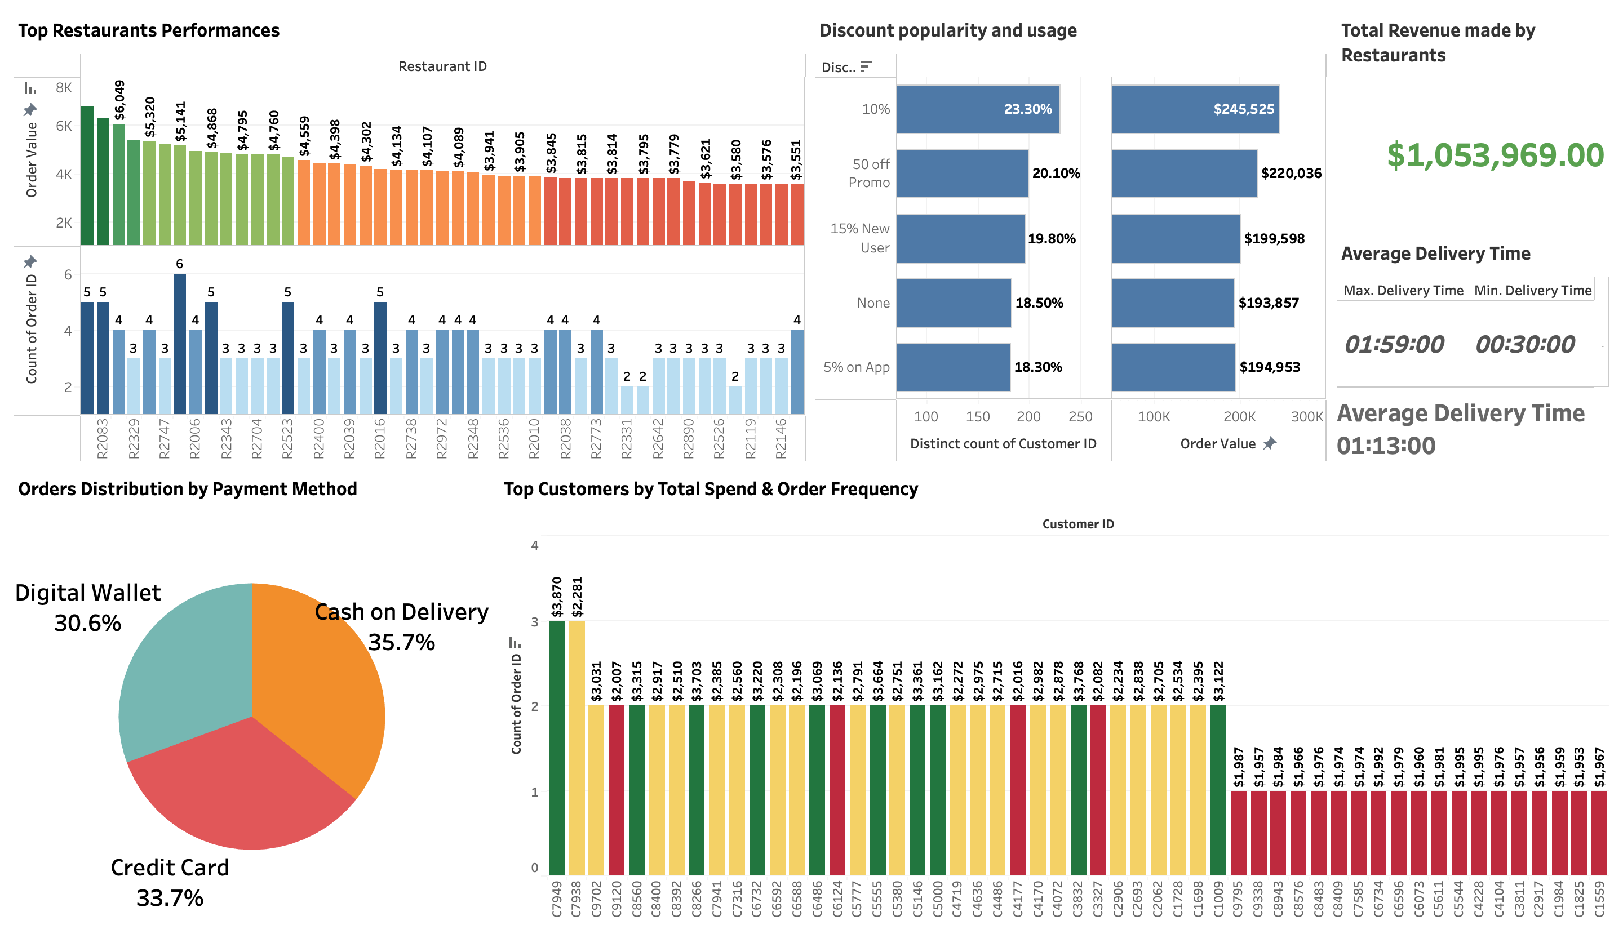
VISUALIZATION

Slide 6
Key insights
The top 3 restaurants generated over $6,000 each in order value and there’s a steep drop in revenue after the top 3, indicating a strong dependency on a few high-performing partners.
Revenue generated by each restaurant isn’t entirely based on the number of orders. Some have high order counts but low revenue, while others make more money from fewer, higher-value orders.
High spending customer does not necessarily mean multiple orders.
Very few repeat customers with high frequency — most customers placed 2–3 orders, indicating low retention.
Total Revenue generated on the platform estimated to $1,239,411, while 75% of that ($1,053,969) is going to the restaurants
The “10% discount” was most used (23.3%) and led to the highest order volume and order value ($245,525).
Interestingly, orders with “No Discounts” still generated $193,857, close to promo-based ones — showing strong organic demand.
Cash on Delivery (35.7%) is still the most preferred payment method.
Average delivery time remains is 1hr 13min, ranging from 30 mins to 1 hr 59 mins depending on location and also delays spike on weekends. (This is a reasonable delivery window, but optimization is possible to reduce time further).

Slide 7
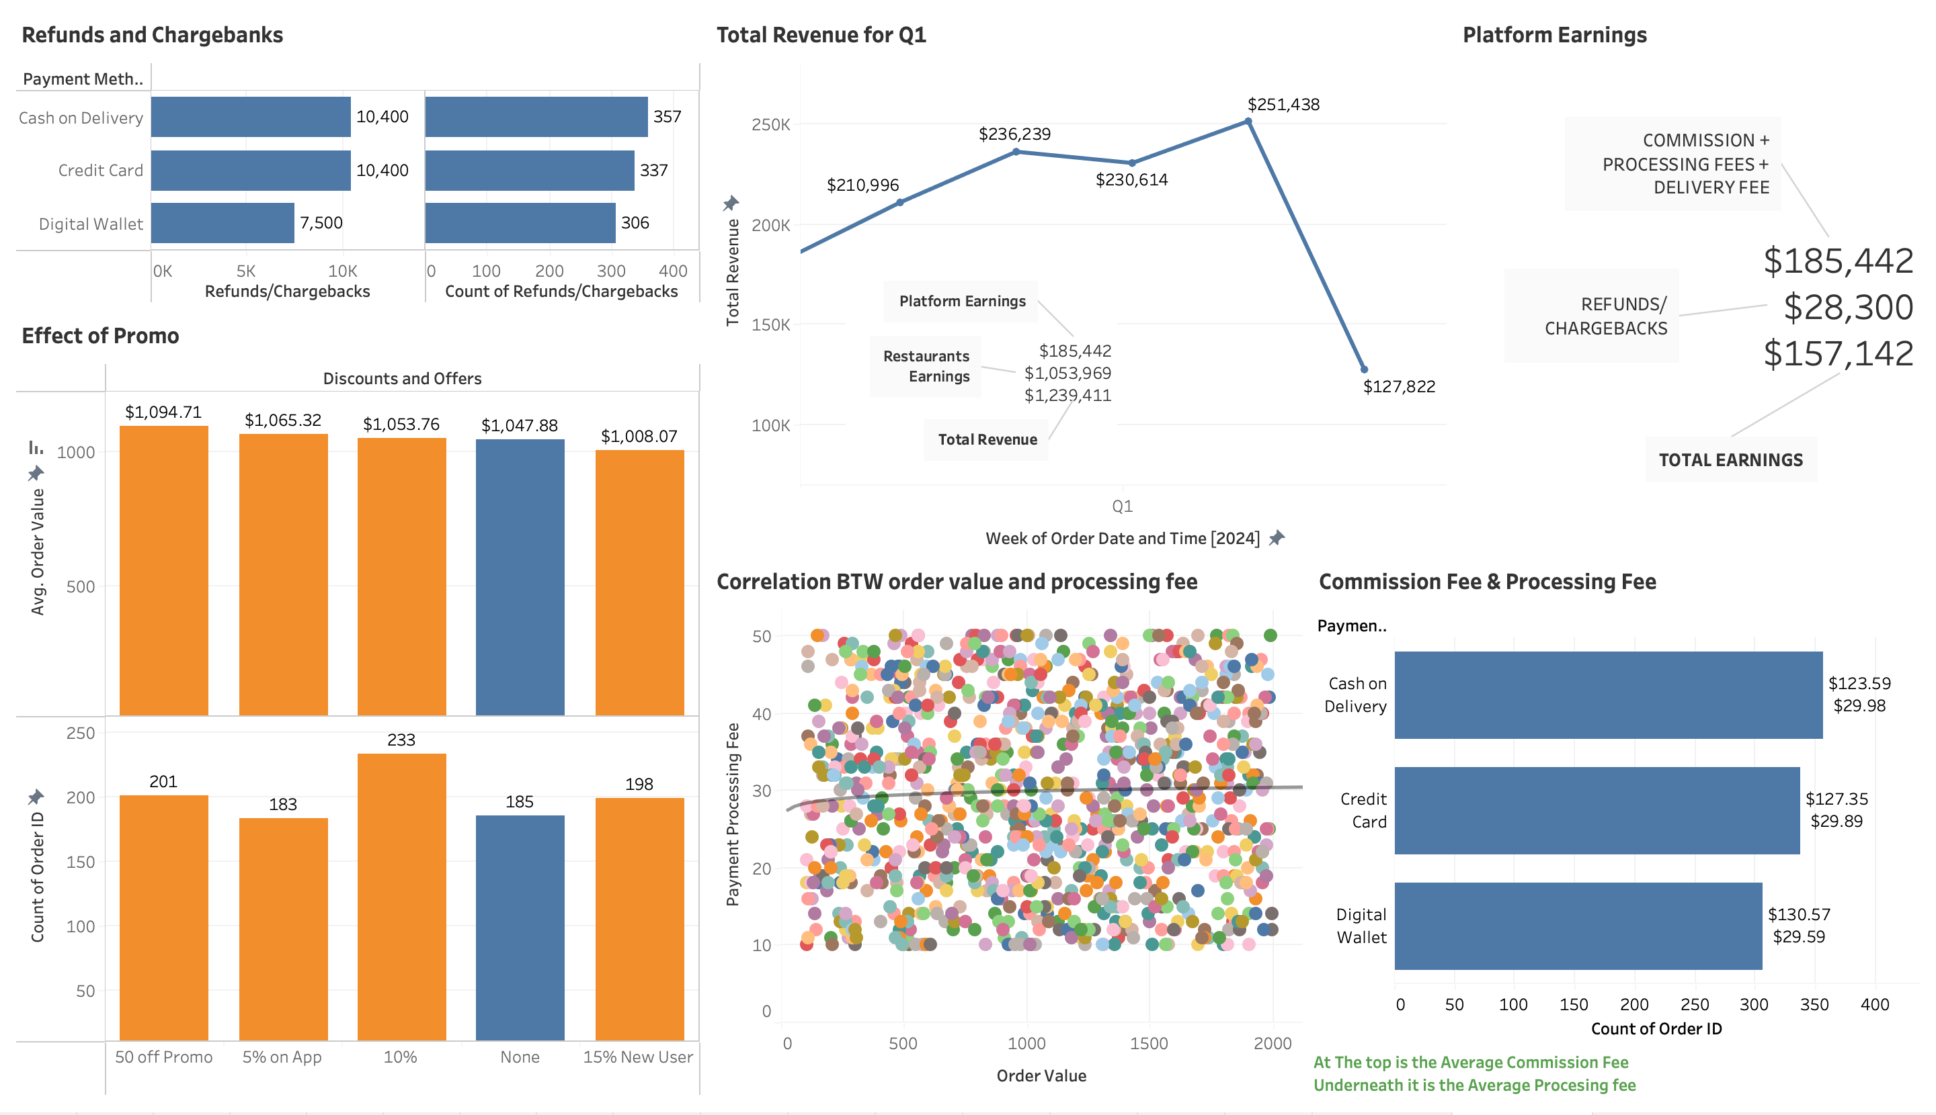
Visualization

Slide 8
KEY INSIGHTS
Discounts have slightly positive effects on order value, at an average of $1,055.5, However, Orders with no discounts or offers averaged at $1,048, showing discounts don’t drastically influence spend
15% of total revenue generated ($158,442) belongs to the platform
Refunds/chargebacks account for over 15% of platform’s gross earnings ($28,300) — a major concern.
Digital Wallets yield the highest commission at Average fee of $130.57, with the lowest processing fee at an average of $29.59, While Cash on Delivery has the lowest commission fee at an average of $123.59 , but the highest processing fee at an average of $29.98.
Cash on delivery has the the highest refund risk wit a total of $10,400 refunds made which is also the same with Credit card charge backs.
With a 30.7% usage of Digital wallet among customers and very low rate of charge backs, there is a growing trust in digital channels.
There was no reasonable correlation between the order value, the payment processing fee and the commission fee — Meaning each payment method have their own distinguished way of charging processing fee, and commission fee must have been specifically negotiated between the restaurants and the platform depending on payment method.

Slide 9
RECOMMENDATION
Reduce Refund Rates
Analyze refund patterns by customer and restaurant.
Restrict COD for high-refund users or require upfront verification.
Incentivize card/digital wallet payments with reward points or minor discounts.
Push for Digital Payments
Promote digital payment usage via limited-time offers (e.g., 5% cashback).
Educate customers on digital wallet benefits and ease-of-use.
Optimize Promotions
Focus on 10% discount campaigns — highest ROI.

Slide 10
THANK YOU

